Slide 1
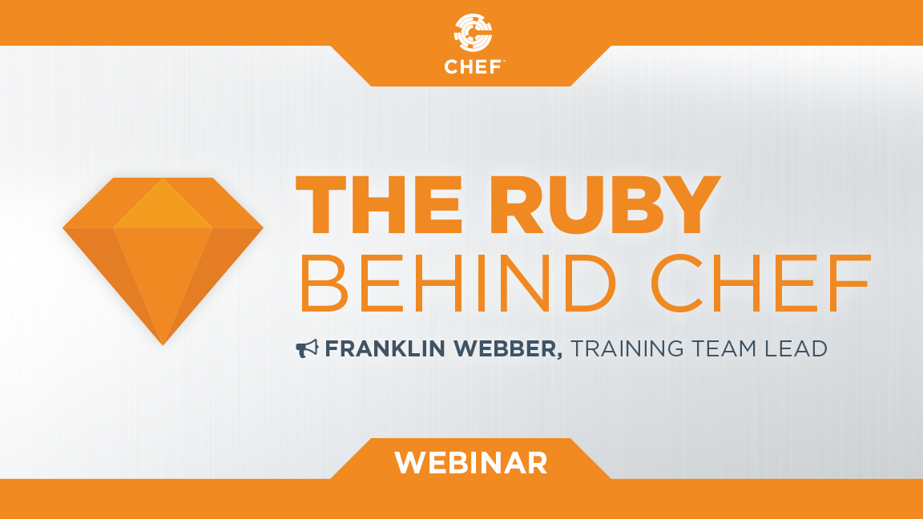
The Ruby Behind Chef
Notes:
Hello everyone and welcome to today’s webinar: ‘The Ruby Behind Chef'

Slide 2

Franklin Webber
Training and Technical Content Lead
Ceci n'est pas un entraîneur
Notes:
My name is Franklin Webber. I'm a training lead here at Chef and I’m honored that you chose to be a part of this session today.

Slide 3
Who I Think You Are ...
Chef Cookbook Author
Write cookbook recipes and define attributes
Curious about Ruby || Frustrated with Ruby
Understanding of some programming concepts (e.g. variables, functions/methods)
Notes:
When creating this presentation I spent a lot of time thinking about who you are to help guide me in preparing the best content to assist you and to define the scope of what to share with you.
First and foremost I made the assumption that you are an author or co-author of cookbooks. By that I mean you have edited or created recipes and defined attributes. During your time working with Chef you have been confronted with errors you did not understand or implementations within community cookbooks that were perplexing. Which has made you curious and maybe even simultaneously frustrated with your lack of understanding of Chef and Ruby.
I also am making an assumption that you have some experience working with some software programming concepts; whether you started learning a little bit of Ruby, Perl, Python, Java, or C#.

Slide 4
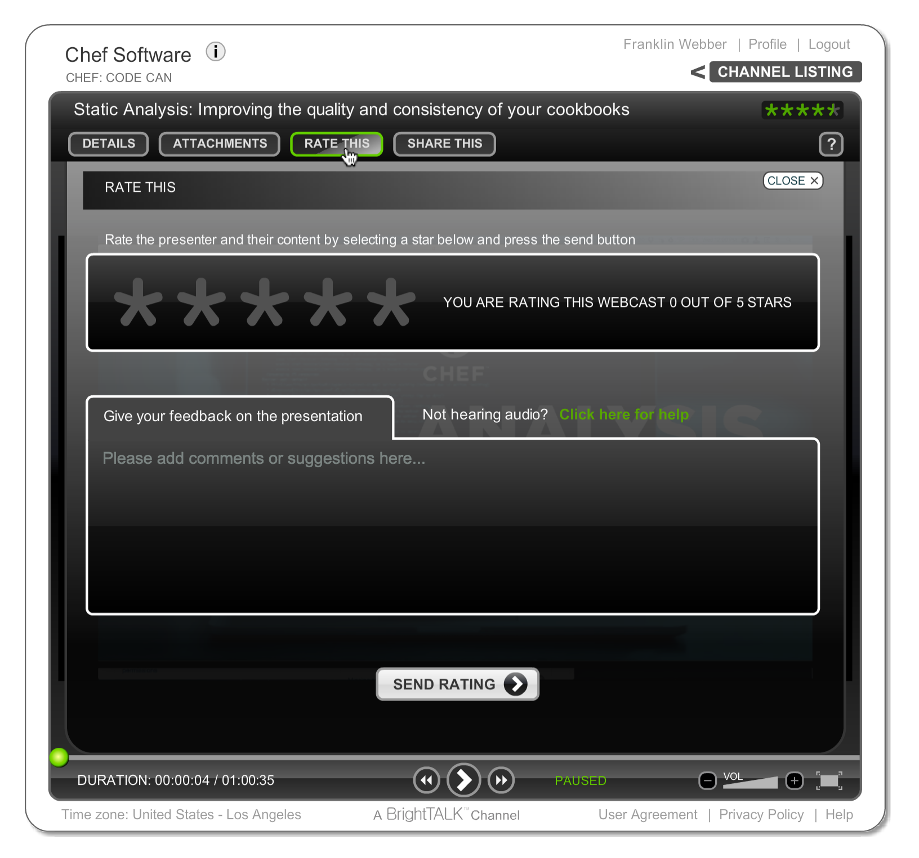
Let Us Know What You Think
"Ask a Question" and I will answer it.
"Rate This" presentation to leave your feedback and help me do my work better.
Email me at franklin@chef.io
Notes:
We’d love to hear from you during today’s presentation. I’ll be answering questions at the end of the session, so please feel free to send those along using the ‘Ask a Question’ tab on the top of your screen.

Slide 5
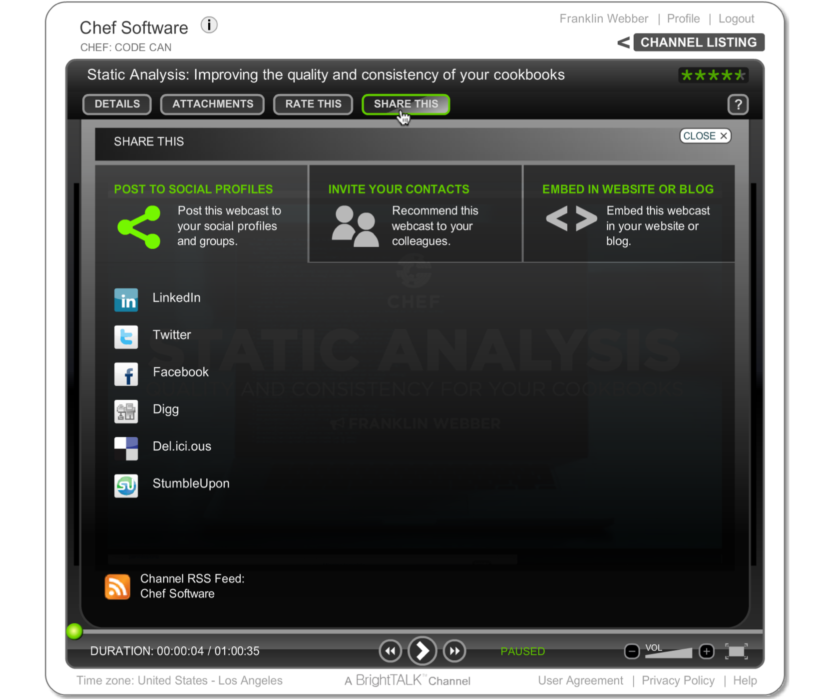
Was this Valuable to You?
Share it with your professional and social networks.
Notes:
Today’s webinar will be available on demand after the live session, accessible through the same link you’re using now.

Slide 6
The Ruby Behind Chef
Notes:
Hello everyone and welcome again to today’s webinar: ‘The Ruby Behind Chef.’

Slide 7
The Ruby Behind Chef
SOME
Notes:
Hello everyone and welcome again to today’s webinar: ‘The Ruby Behind Chef.’

Slide 8
The Ruby Behind Chef
SOME
A POSSIBLE VERSION
Notes:
Hello everyone and welcome again to today’s webinar: ‘The Ruby Behind Chef.’

Slide 9

The Ruby Behind Chef
SOME
A POSSIBLE VERSION
T-REX ENHANCED
Photo: mcdlttx @ https://flic.kr/p/GXN8d
Notes:
Hello everyone and welcome again to today’s webinar: ‘The Ruby Behind Chef.’

Slide 10

My Core Philosophy ...
MDD
Photo: Ginny @ https://flic.kr/p/7ZUJze

Slide 11
My Core Philosophy ...
MDD
Mascot Driven Development
Photo: Ginny @ https://flic.kr/p/7ZUJze

Slide 12
So Let's Build:
T-Rex Chef
Photo: Ginny @ https://flic.kr/p/7ZUJze

Slide 13
What makes our Chef better?
Killer Fast
Tiny Features
Photo: Ginny @ https://flic.kr/p/7ZUJze

Slide 14
First Feature: Parsing A Recipe
Load a Recipe File
Evaluate Core Resources
Evaluate Resource Blocks
Questions
Wrap-Up and Further Resources

Slide 15
File#read
A File is an abstraction of any file object accessible by the program and is closely associated with class IO. File includes the methods of module FileTest as class methods, allowing you to write (for example) File.exist?("foo").
Opens the file, optionally seeks to the given offset, then returns length bytes (defaulting to the rest of the file). read ensures the file is closed before returning.
http://www.rubydoc.info/stdlib/core/File

Slide 16
Kernel#eval
The Kernel module is included by class Object, so its methods are available in every Ruby object.
Evaluates the Ruby expression(s) in string. If binding is given, which must be a Binding object, the evaluation is performed in its context. If the optional filename and lineno parameters are present, they will be used when reporting syntax errors.
http://www.rubydoc.info/stdlib/core/Kernel#eval-instance_method

Slide 17
Second Feature: Core Resources
Load a Recipe File
Evaluate Core Resources
Evaluate Resource Blocks
Questions
Wrap-Up and Further Resources

Slide 18
Resources
file '/hello.txt' do
content 'Hello, world!'
action :create
end
The TYPE named NAME should be ACTION'd with PROPERTIES

Slide 19
Resources
file '/hello.txt' do
content 'Hello, world!'
action :create
end
The TYPE named NAME should be ACTION'd with PROPERTIES

Slide 20
Resources
file '/hello.txt' do
content 'Hello, world!'
action :create
end
The TYPE named NAME should be ACTION'd with PROPERTIES

Slide 21
Resources
file '/hello.txt' do
content 'Hello, world!'
action :create
end
The TYPE named NAME should be ACTION'd with PROPERTIES

Slide 22
Resources
file '/hello.txt' do
content 'Hello, world!'
action :create
end
The TYPE named NAME should be ACTION'd with PROPERTIES

Slide 23
A Ruby Method with One Parameter
def file(name)
# contents of method
end
The method named 'file' has a single parameter named 'name'.

Slide 24
Third Feature: Resource Blocks
Load a Recipe File
Evaluate Core Resources
Evaluate Resource Blocks
Questions
Wrap-Up and Further Resources

Slide 25
Resources
file '/hello.txt' do
content 'Hello, world!'
action :create
end
The TYPE named NAME should be ACTION'd with PROPERTIES

Slide 26
Blocks in Ruby
Think of it as a way to pass code you can execute instead of a value.
Some people might call them anonymous functions. This is because blocks have code that they execute but have not been given a name.

Slide 27
A Ruby Method Always has a Block
def file(name,&block)
# contents of method
end
The method named 'file' has a single parameter named 'name' and explicitly names the block 'block'. (The & in front is a way to grab that block).

Slide 28
A Ruby Method Always has a Block
def file(name,&block)
# invoking the block with the explicit name
block.call
# invoking the block with the implicit name
yield if block_given?
end
A block can be invoked with the explicit name or with the implicit block syntax.

Slide 29
Passed Blocks Become Procs
Proc objects are blocks of code that have been bound to a set of local variables. Once bound, the code may be called in different contexts and still access those variables.
rubydoc.info/stdlib/core/Proc

Slide 30
Discussion and Questions
Load a Recipe File
Evaluate Core Resources
Evaluate Resource Blocks
Questions
Wrap-Up and Further Resources

Slide 31
Let Us Know What You Think
Email me at franklin@chef.io
"Rate This" presentation to leave your feedback and help me do my work better.

Slide 32
Q&A
What questions can I answer for you?

Slide 33
Agenda
Load a Recipe File
Evaluate Core Resources
Evaluate Resource Blocks
Questions
Wrap-Up and Further Resources

Slide 34
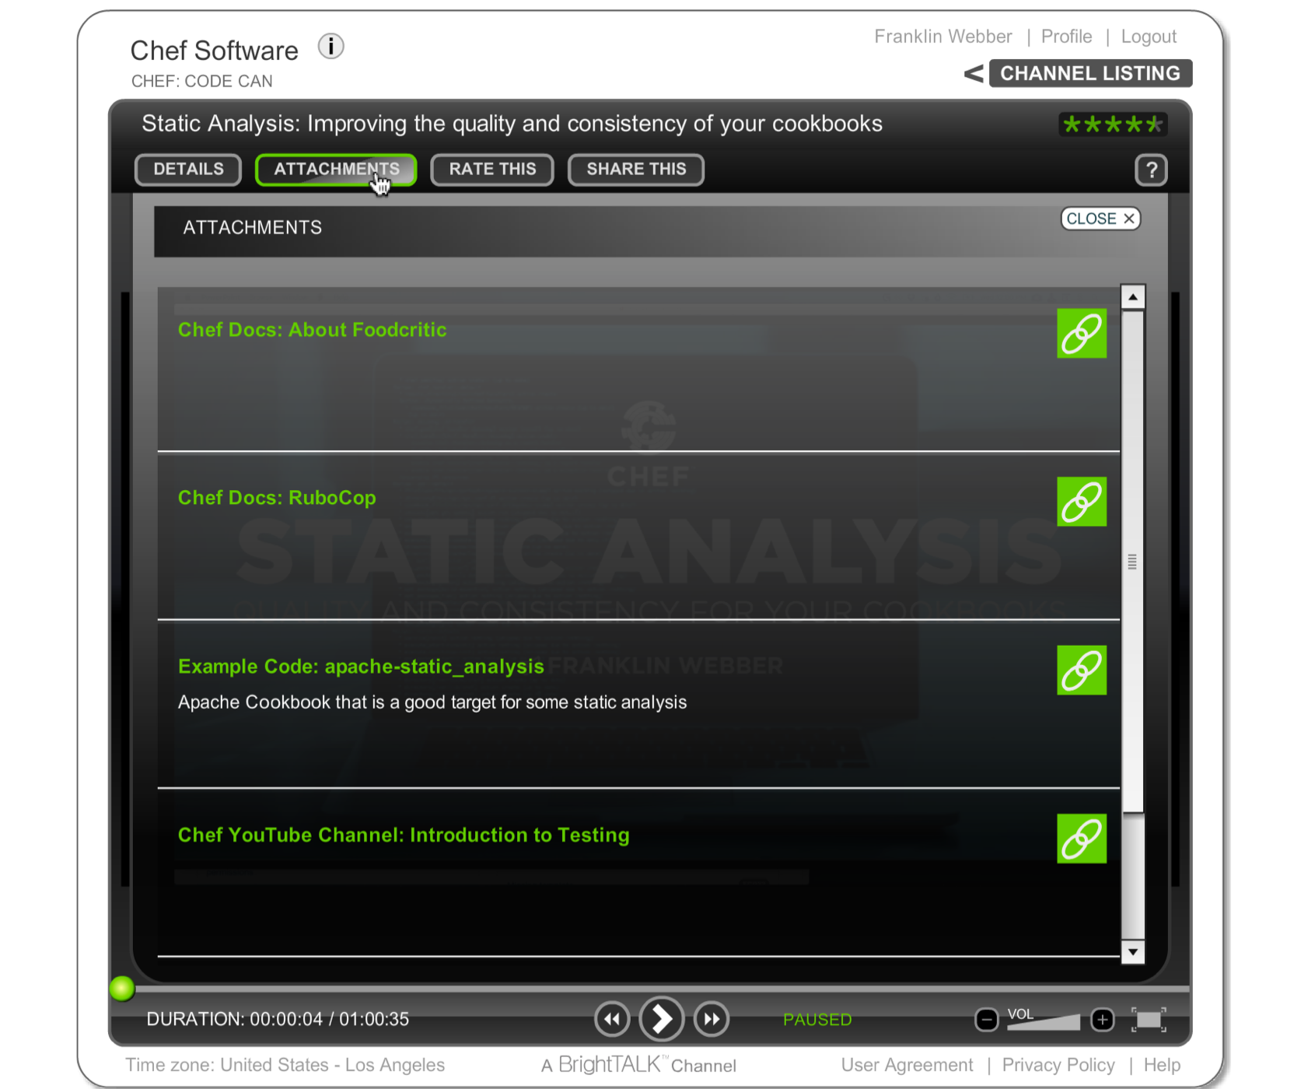
BrightTALK Attachments
All of the resources I am going to provide you can be found under "Attachments".

Slide 35

exercism.io
Level up your programming skills

Slide 36
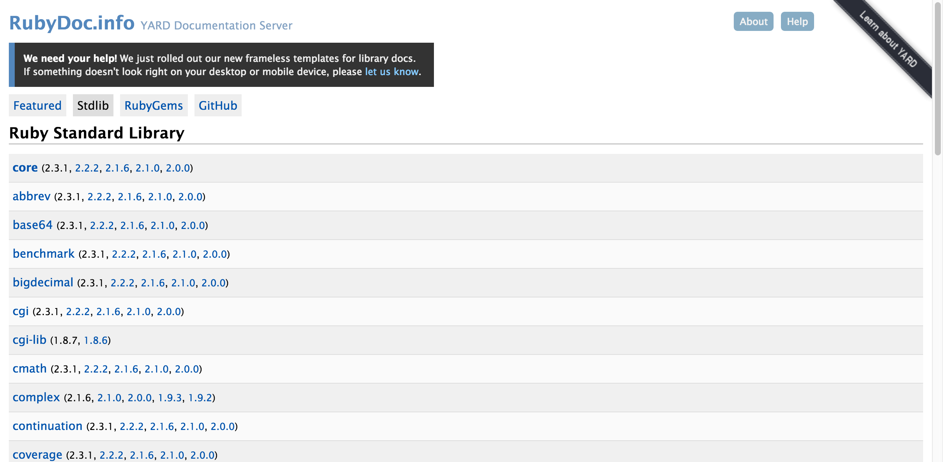
Ruby Documentation
www.rubydoc.info/stdlib

Slide 37
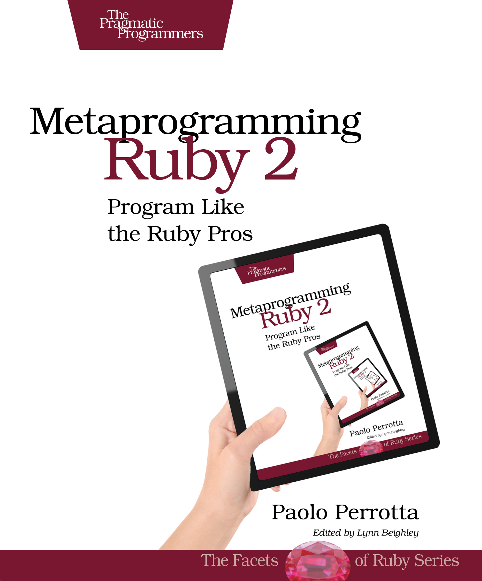
Metaprogramming Ruby 2
pragprog.com/book/ppmetr2/metaprogramming-ruby-2

Slide 38
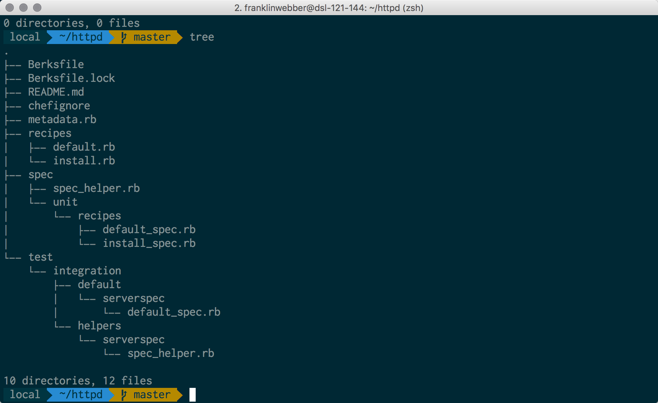
My Terminal
Mac OSX
iTerm2
Oh My Zsh
Agnoster Theme
Powerline Patched Font

Slide 39
Agenda
Load a Recipe File
Evaluate Core Resources
Evaluate Resource Blocks
Questions
Wrap-Up and Further Resources

Slide 40
NOW WITH MORE T-REX

